Slide 1

Introduction to Amazon Sales Analysis
This presentation delves into the analysis of Amazon's sales data, uncovering key insights and trends that can help drive strategic decision-making. We'll explore the data sources, dive into crucial metrics, and present visually compelling visualizations to paint a comprehensive picture of Amazon's sales performance.
BY SATVIK PRASAD S

Slide 2


About Amazon
Ecommerce Giant
Diverse Business Model
Customer-Centric Approach
Amazon is the world's largest online marketplace, offering a vast selection of products and services to customers globally.
Beyond e-commerce, Amazon has expanded into cloud computing, digital streaming, logistics, and more, making it a diversified technology powerhouse.
Amazon's relentless focus on customer satisfaction has been a key driver of its success, with innovative services and a commitment to convenience.

Slide 3
Data Sources and Preparation
1
Sales Records
2
Data Cleaning
Comprehensive data on product sales, including revenue, units sold, and customer demographics.
Data cleaning was performed on the provided dataset to eliminate any discrepancies and ensure consistency.
3
Analysing Sales Patterns
4
Conclusion and Key Takeaways
This involves examining the trends and factors influencing customer purchasing behavior.
Summarizes the main findings and insights derived from the analysis, highlighting the significant outcomes and their implications

Slide 4

Key Metrics and Visualizations
1
Sales Revenue and Profit
Track total sales revenue over time to identify growth trends and seasonal patterns.
2
Unit Sales and Costs
Analyze the number of units sold to understand customer demand and product popularity.
3
Region and Country Analysis
Monitor Countries wise customer purchase and retention rates to evaluate marketing strategies.

Slide 5
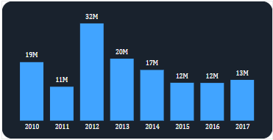
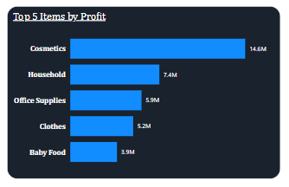
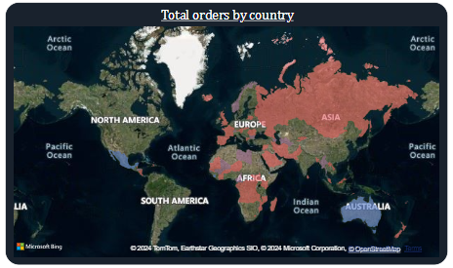
Insights and Trends
Sustained Growth
Product Popularity
Countries Purchased
Amazon has consistently experienced year-over-year growth in sales revenue but had a dip in last couple of years , with a most sales were in month of November
Cosmetics ,Household, Office Supplies, Cloths and Baby Food are among the most popular product categories on Amazon, indicating customer preferences.
Honduras, Mexico, and Myanmar are among the countries with the highest number of orders on Amazon.

Slide 6
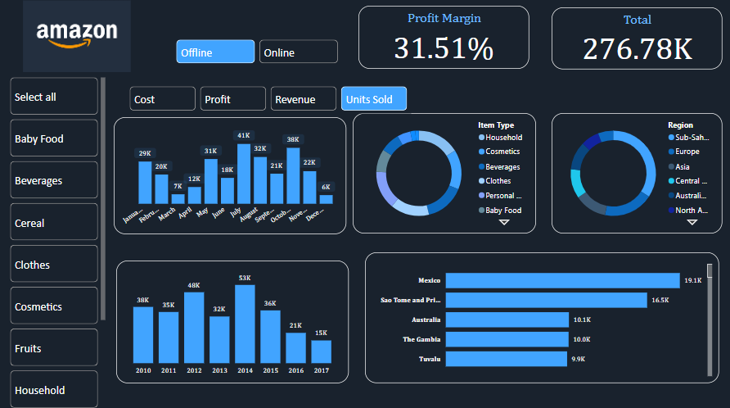
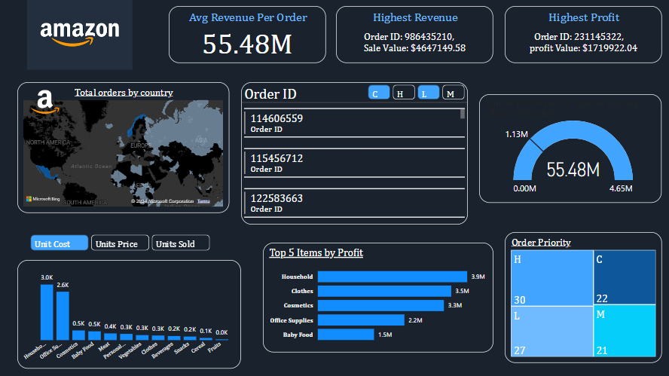
Dashboard View
.
.
Customizable Filters
Interactive Visualizations
Used Dynamic slicers
The dashboard will allow users to apply various filters, such as by product category, profit ,revenue, Oder priority to gain specific insights tailored to their needs
The dashboard will feature dynamic visualizations that enable users to explore the data, uncover trends, and identify opportunities for growth
The dashboard will be designed to allow filtering by cost, revenue, profits, and units sold. This approach will enable effective use of space and create an attractive and user-friendly interface.

Slide 7




Conclusion and Recommendations
Key Takeaways
Identified which regions and countries contribute the most to sales and profit.
Determined which item types generate the most revenue and profit.
Compared the performance between online and offline sales channels.
Analyzed how order priority affects sales and profit.
Examined how sales and profits vary over time (e.g., by month or year).
Strategic Recommendations
Invest more in marketing and inventory for high-performing regions and top-selling products.
Enhance the online sales channel if it underperforms compared to offline sales.
Review and adjust pricing strategies for low-performing products or regions.
Other impact of different order priorities and adjust strategies to maximize profits
Review and adjust pricing strategies for underperforming products or regions to boost sales.
Next Steps
Compare the profitability of online vs. offline sales.
Determine which products have the highest sales and profit margins.
Perform a time series analysis to identify sales trends over time.
Develop and implement strategies based on the analysis to improve sales and profitability.

